Slide 1
Baye’s Rule

Slide 2
Definition
It is a way of finding a probability when we know certain other probabilities.

Slide 3
Bayesian Approaches
Derive the probability of an event given another event
Often useful for diagnosis:
  If X are (observed) effects and Y are (hidden) causes,
  We may have a model for how causes lead to effects (P(X | Y))
  We may also have prior beliefs (based on experience) about the frequency of occurrence of effects (P(Y))
  Which allows us to reason abductively from effects to causes (P(Y | X)).
has gained importance recently due to advances in efficiency
  more computational power available
  better methods

Slide 4

Bayes’ Theorem
We again consider the conditional probability statement:
P(A|B) = P(A ∩ B)
P(B) = P(A ∩ B)
P(B|A₁)P(A₁) + P(B|A₂)P(A₂) + ··· + P(B|A_{n})P(A_{n})
in which we have used the Theorem of Total Probability to replace P(B). Now
P(A ∩ B) = P(B ∩ A) = P(B|A) × P(A)
Substituting this in the expression for P(A|B) we immediately obtain the result
P(A|B) = P(B|A) × P(A)
P(B|A₁)P(A₁) + P(B|A₂)P(A) + ··· + P(B|A_{n})P(A_{n})
This is true for any event A and so, replacing A by Ai gives the result, known as Bayes’ Theorem
as
P(A_{i}|B) = P(B|A_{i}) × P(A_{i})
P(B|A₁)P(A₁) + P(B|A₂)P(A₂) + ··· + P(B|A_{n})P(A_{n})
This equation is known as Bayes' rule (also Bayes' law or Bayes' theorem).
This simple equation underlies all modern AI systems for probabilistic inference.

Slide 5
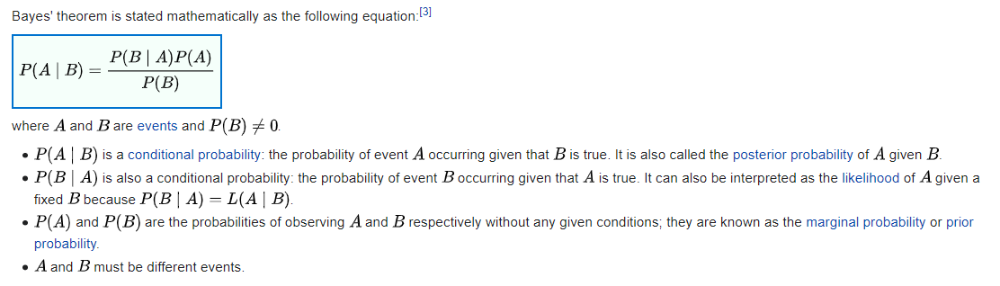
Formula

Slide 6
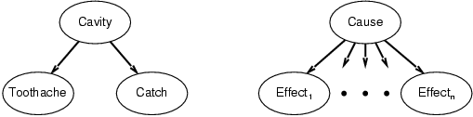
Bayes' Rule and conditional independence
P(Cavity | toothache ∧ catch)
  = αP(toothache ∧ catch | Cavity) P(Cavity)
  = αP(toothache | Cavity) P(catch | Cavity) P(Cavity)
This is an example of a naïve Bayes model:
  P(Cause,Effect₁, … ,Effect_{n}) = P(Cause) π_{i}P(Effect_{i}|Cause)
Total number of parameters is linear in n
A single cause directly influences a number of effect, all of which are conditionally independent, given the cause. The full joint distribution can be written as
Such a probability distribution is called a Naïve Bayes model. Some times called Bayesian classifier

Slide 7
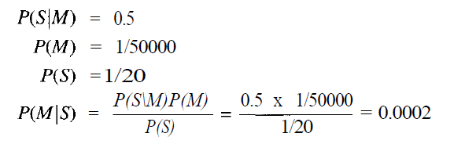
Simple Example Problem
A doctor knows that the disease meningitis is causes the patient to have a stiff neck, say, 50% of the time. The doctor also knows some unconditional facts: the prior probability of a patient having meningitis is 1/50,000, and the prior probability of any patient having a stiff neck is 1/20. Letting S be the proposition that the patient has a stiff neck and M be the proposition that the patient has meningitis.

Slide 8
Another example
You are planning a picnic today, but the morning is cloudy
Oh no! 50% of all rainy days start off cloudy!
But cloudy mornings are common (about 40% of days start cloudy)
And this is usually a dry month (only 3 of 30 days tend to be rainy, or 10%)
What is the chance of rain during the day?

Slide 9
Cont…
We will use Rain to mean rain during the day, and Cloud to mean cloudy morning.
The chance of Rain given Cloud is written P(Rain|Cloud)
So let's put that in the formula:
P(Rain|Cloud) = P(Rain) P(Cloud|Rain)P(Cloud)
P(Rain) is Probability of Rain = 10%
P(Cloud|Rain) is Probability of Cloud, given that Rain happens = 50%
P(Cloud) is Probability of Cloud = 40%
P(Rain|Cloud) = 0.1 x 0.50.4 = .125
Or a 12.5% chance of rain. Not too bad, let's have a picnic!

Slide 10
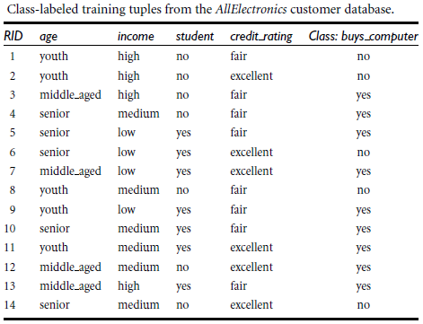
EXAMPLE PROBLEM
The training data are in above Table. The data tuples are described by the attributes age, income, student, and credit rating. The class label attribute, buys computer, has two distinct values (namely, yes, no). Let C₁ correspond to the class buys computer = yes and C₂ correspond to buys computer = no. The tuple we wish to classify is X = (age = youth, income = medium, student = yes, credit rating = fair)

Slide 11
We need to maximize P(X|C_{i})P(C_{i}), for i = 1, 2. P(C_{i}), the prior probability of each class, can be computed based on the training tuples:
    P(buys computer = yes) = 9/14 = 0.643
    P(buys computer = no) = 5/14 = 0.357
To compute P(X|C_{i}), for i = 1, 2, we compute the following conditional probabilities:

Slide 12
P(age = youth | buys computer = yes) = ?
P(age = youth | buys computer = no) = ?
P(income = medium | buys computer = yes) = ?
P(income = medium | buys computer = no) = ?
P(student = yes | buys computer = yes) = ?
P(student = yes | buys computer = no) = ?
P(credit rating = fair | buys computer = yes) = ?
P(credit rating = fair | buys computer = no) = ?
The above full join distribution can be written as

Slide 13
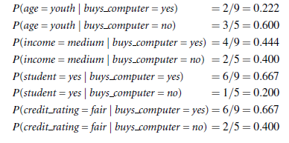

Slide 14

= 0.222 X 0.444 X 0.667 X 0.667 = 0.044
Similarly,
P(X | buys computer = no)
= 0.600 X 0.400 X 0.200 X 0.400 = 0.019
To find the class, Ci, that maximizes P(XjCi)P(Ci), we compute
P(X | buys computer = yes)P(buys computer = yes) = ?
P(X | buys computer = no)P(buys computer = no) = ?

Slide 15
P(X | buys computer = yes)P(buys computer = yes) =0.044 X 0.643 = 0.028
P(X | buys computer = no)P(buys computer = no) =0.0918 X 0.357 = 0.007
Therefore, the naïve Bayesian classifier predicts buys computer = yes for tuple X.

Slide 16
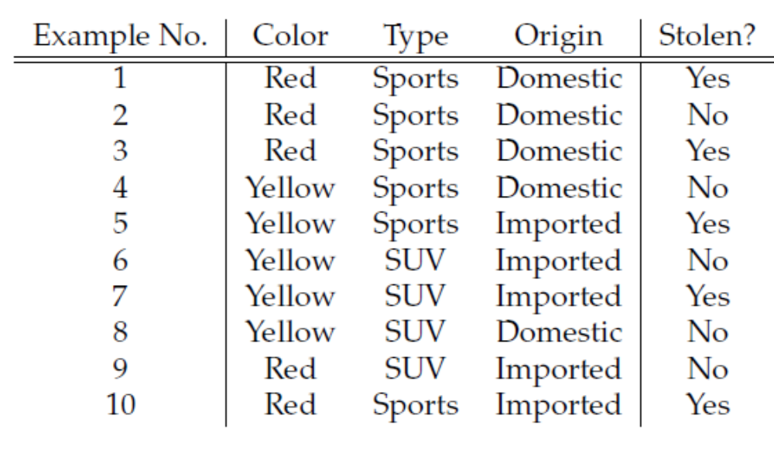
Practice Problem 1
X = (color= red, Type = SUV, Origin = Domestic)

Slide 17
We have P(Yes) = .5 and P(No) = .5,
For v = Y es, we have P(Yes) * P(Red | Yes) * P(SUV | Yes) * P(Domestic|Yes) = .5 * .56 * .31 * .43 = .037
For v = No, we have P(No) * P(Red | No) * P(SUV | No) * P (Domestic | No) = .5 * .43 * .56 * .56 = .069
Since 0.069 > 0.037, our example gets classified as ’NO
X = (color= red, Type = SUV, Origin = Domestic) => Stolen=NO

